Slide 1

RAMAIAH INSTITUTE OF TECHNOLOGY (Autonomous Institute Affiliated to VTU)
Department of Information Science and Engineering
Topic : Object Detection and Measurement of its size

Slide 2
TEAM - 1
Syed Adil Naqvi - 1MS19IS128
Vedant Sharma - 1MS19IS137

Slide 3
I
Introduction

Slide 4
Introduction
In these days, real-time object detection and dimensioning of objects is an important issue from many areas of industry.
This is a vital topic of computer vision problems.
This study presents an enhanced technique for detecting objects and computing their measurements in from pictures.

Slide 5
The proposed system can be applied to an industrial quality control system.
Likewise, it can be utilized for various industrial systems or for security purposes.
Generally, it is identifying objects in public area and measure dimensions of each of them.

Slide 6
II
Literature Survey

Slide 7
Literature Survey
Survey by Rupesh Kumar (Department of Computer Science and Engineering National Institute of Technology Rourkela, Odisha – 769 008, India)
Object detection and tracking are important and challenging task in many computer vision applications such as surveillance, vehicle navigation and autonomous robot navigation. Video surveillance in dynamic environment, especially for humans and vehicles, is one of the current challenging research topics in computer vision.
It is a key technology to fight against terrorism, crime, public safety and for efficient management of traffic. The work involves designing of efficient video surveillance system in complex environments. In video surveillance, detection of moving objects from a video is important for object detection, target tracking, and behaviour understanding.

Slide 8
III
Problem Statement

Slide 9
Problem Statement
Object Detection and identification is become a more growing requirement in the society due to numerous reasons.
The main purpose of object detection is to identify and locate one or more effective targets from still image or video data.
It comprehensively includes a variety of important techniques, such as image processing, pattern recognition, artificial intelligence and machine learning.
Specifically, object detection draws bounding boxes around these detected objects, which allow us to locate where said objects are in (or how they move through) a given scene.

Slide 10
IV
System Block Diagram

Slide 11
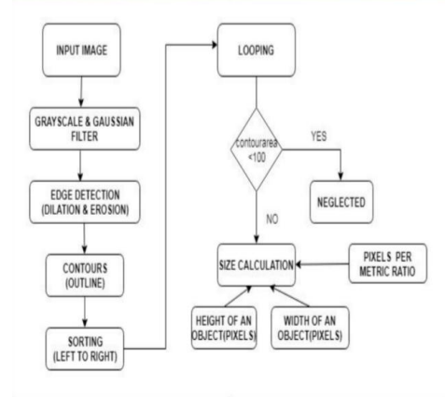
Block Diagram:

Slide 12
V
Proposed Algorithm

Slide 13
Proposed Algorithm
In the proposed system, firstly, we need to preprocess our image. The camera will capture a frame and the frame will convert to grayscale to increase quickness and accuracy.
Objects are detected via canny edge detector algorithm. It is used to detect only one object or multiple objects. By the help of canny edge detector, the converted image will be processed. The canny edge algorithm scans the entire image
After that, execute dilation and erosion algorithm to close holes among edges in the edge frame
We detect contours by using an OpenCV function that is cv2.findContours to find the shapes of the objects in the edge map. We arrange contours from left to right. The reference object in the frame is permanently the left one.

Slide 14
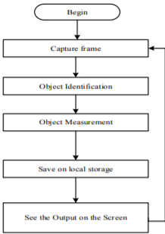
By depending to the reference object, we calibrate the camera and set the value of parameter. Next, we scan every contours, begin looping above every individual contours.
After that, the rectangle around objects will be drawn in green. So, the points of the bounding box rectangle will draw in a small purple rounds. After that, we can get midpoints because the bounding box is ordered.
Finally, we calculate pixels Per Metric variable through dependence on reference object. The height-distance in pixels will put on hD (height) variable and width distance will put on wD (width) variable.

Slide 15
VI
Results

Slide 16
Results
The main benefit of these markers is that a single marker provides enough correspondences (its four corners) to obtain the camera pose. Also, the inner binary codification makes them specially robust, allowing the possibility of applying error detection and correction techniques.
We choose an aruco marker from the dictionary (5X5_50) and as we know its dimensions which is 5x5 (perimeter=20 cm) , we use it to find the measurement of the object.
The aruco marker just need to be there with the object itself in the video and we get the required object measurement with a 96-98% accuracy.

Slide 17
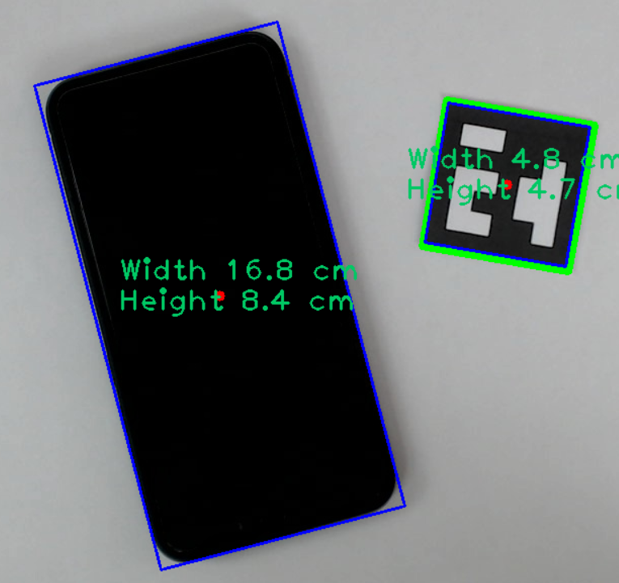
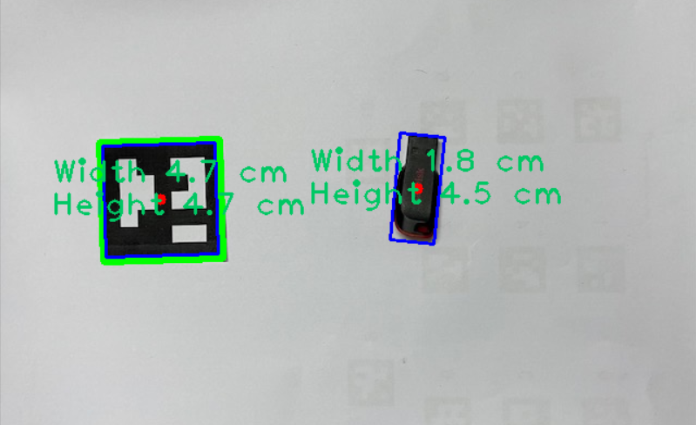

Slide 18
VII
Conclusion

Slide 19
Conclusion
The identification of an object is based on taking two images in the same scenario without and with the object present in an image.
The identified objects is distinguished by the size of object area displayed and the co-ordinates. The output obtained from these images are taken as input data for the equations to calculate the size.
Based on the tests conducted, by considering various heights and distances of an object, andusing various objects, it was found that the deviation of the measurement from original measurement is less than 7-10%.

Slide 20
VIII
References

Slide 21
References
Muthukrishnan.R and M.Radha “Edge Detection Techniques for image Segmentation” International Journal of Computer Science & Information Technology (IJCSIT) Vol3, No 6, Dec 2011.
Geng Xing, Chen ken , Hu Xiaoguang “An improved Canny edge detection algorithm for color image” IEEE TRANSACTION ,2012 978-1- 4673-0311-8/12/$31.00 ©2012 IEEE.
OpenCV, 2016. http://opencv.org/.[Accessed December 23, 2016]
D. Webster, “A pulsed ultrasonic distance measurement system based upon phase digitizing,” IEEE Transaction on Instrumentation and Measurement, Vol. 43, No. 4, Aug. 1994, pp. 578-582.

Slide 22
Y. Jang, S. Shin, J. W. Lee, and S. Kim, “A preliminary study for portable walking distance measurement system using ultrasonic sensors,” Proceedings of the 29th Annual IEEE International Conference of the EMBS, France, Aug. 2007, pp. 5290-5293.
Y. y. Zheng, J. l. Rao and L. Wu, "Edge detection methods in digital image processing," 2010 5th International Conference on Computer Science & Education, Hefei, 2010, pp. 471-473.

